Slide 1
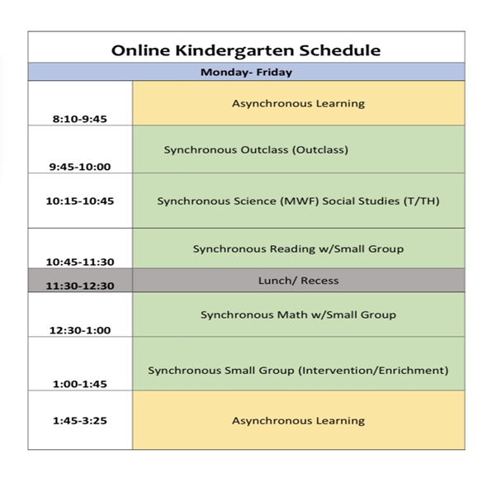
Online Kindergarten Schedule

